Slide 1

COMPUTER NETWORKS
(BCSC 0008)
Copyright content, use only with the written permission of presenter mentioned
Lecture 21

Slide 2
Text and Reference Books
Text Books:
Fourouzan B. A. (2004), “Data Communication and Networking”, 4th Edition, McGraw-Hill.
References:
Kurose, J. F. and Ross K. W. (2005), “Computer Networking: A Top-Down Approach Featuring the Internet”, 3rd Edition, Addison-Wesley.
A. S. Tanenbaum (2006), “Computer Networks”, 2nd Edition, Prentice Hall India.

Slide 3
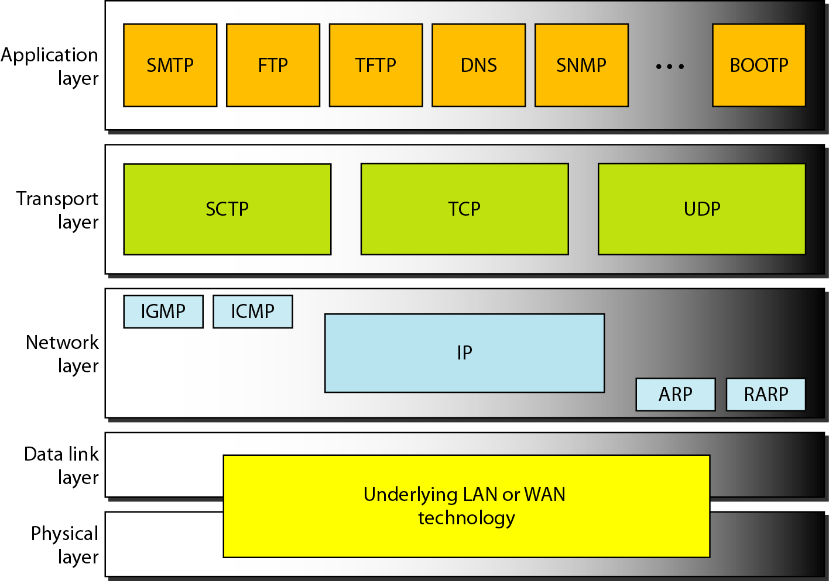
Transport Layer: Introduction

Slide 4
Transport Layer Protocols (UDP and TCP)
UDP provides
  best effort delivery
  Connectionless
  Unreliable
  Out of order delivery
TCP
  Reliable
  In-order delivery
  Congestion control
  Flow control
  Connection setup

Slide 5
USER DATAGRAM PROTOCOL (UDP)
The User Datagram Protocol (UDP) is called a connectionless, unreliable transport protocol. It does not add anything to the services of IP except to provide process-to-process communication instead of host-to-host communication.

Slide 6
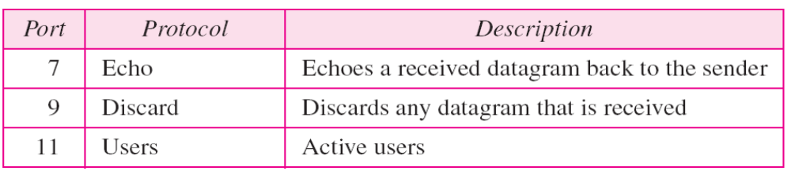
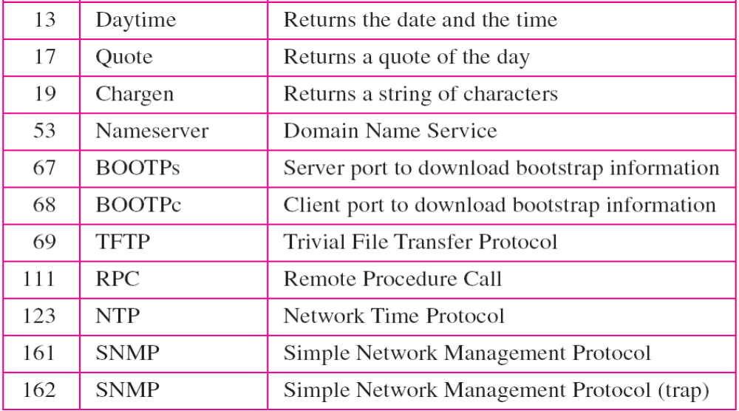
Well-known ports used with UDP

Slide 7
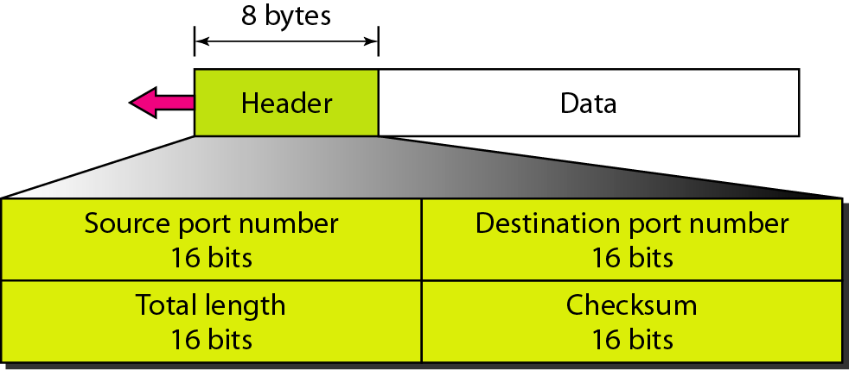
User datagram format

Slide 8
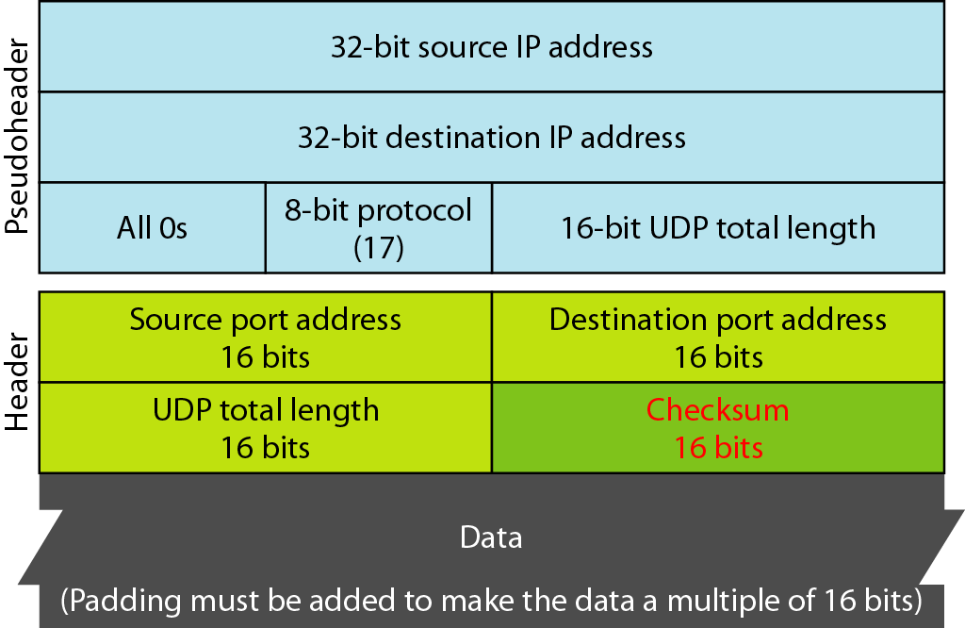
Pseudoheader for checksum calculation

